Slide 1

Ride the wave: ReSurfEMG
Dr. Candace Makeda Moore, MD
Notes:
this is 5min version of our 30min slidedeck :-)

Slide 2

Before this tutorial:
WARNING:
Conda or mamba and GIT should be on your machine!
See the learning repo for all requirements!
Energizer
Breakout for readiness

Slide 3
Structure of this tutorial
1. Who are we, what is ReSurfEMG?
2. Version control
3. Command line synthesis
4. Dashboard
5. Researcher Interface
Alternatives
Sustainability
Discussion

Slide 4
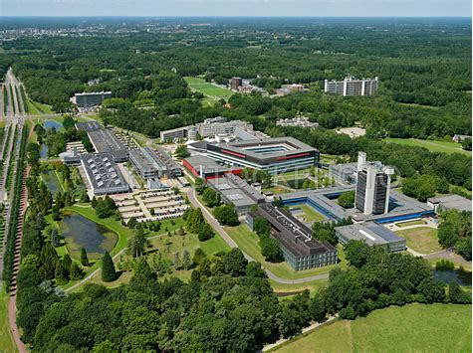
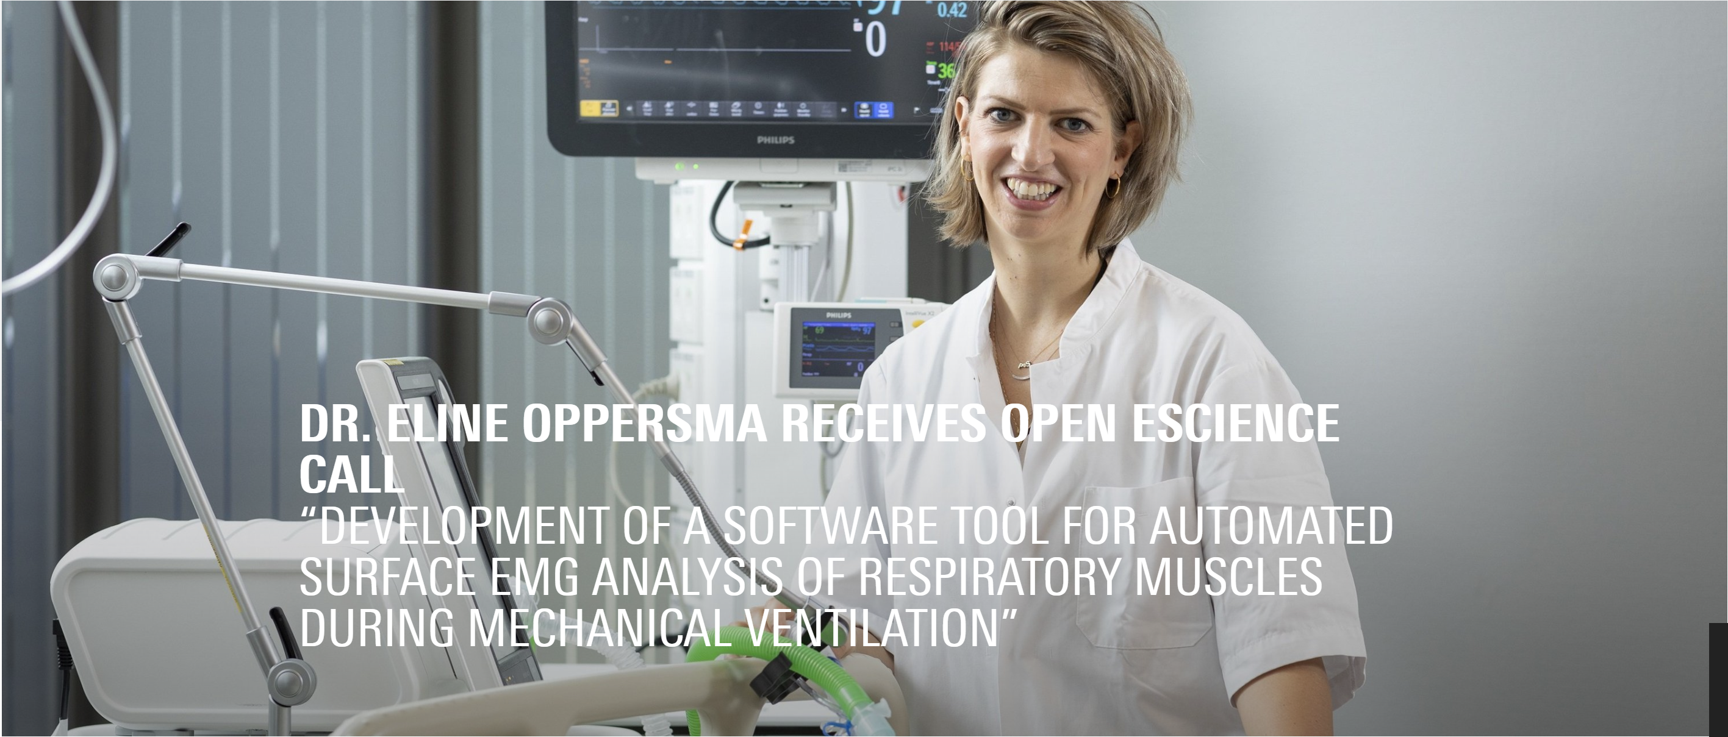
Netherlands eScience Center called,
University of Twente answered
Dr. Eline Mos-Oppersma from the Cardiovascular and Respiratory Physiology group won a call from NleSC, and partnered with us.
Notes:
And our mission is empowering researchers across all disciplines through innovative research software.
The Netherlands eScience Center is the national centre for innovative software solutions in academic research. It was founded in 2012 as an independent foundation by NWO and SURF.
Our Mission: Empowering researchers across all disciplines through innovative research software.
Our Vision: Our vision is a thriving research community where researchers in all disciplines can make use of advanced software, computing and digital technologies, keeping the Netherlands at the forefront of research.

Slide 5
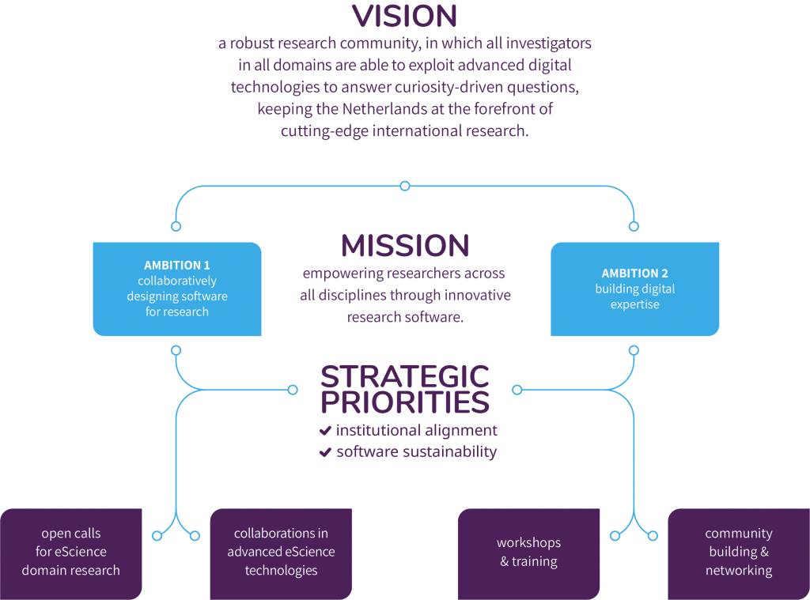


Netherlands eScience Center
Notes:
And our mission is empowering researchers across all disciplines through innovative research software.
The Netherlands eScience Center is the national centre for innovative software solutions in academic research. It was founded in 2012 as an independent foundation by NWO and SURF.
Our Mission: Empowering researchers across all disciplines through innovative research software.
Our Vision: Our vision is a thriving research community where researchers in all disciplines can make use of advanced software, computing and digital technologies, keeping the Netherlands at the forefront of research.

Slide 6
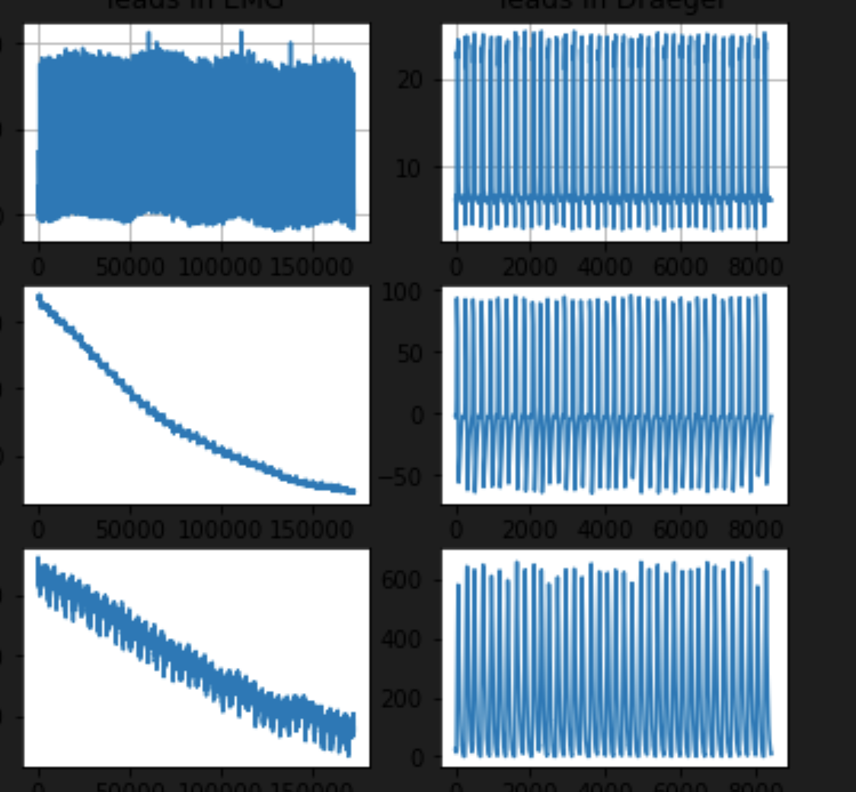
Signals!
Surface EMG background
Electromyogram (EMG) measured at the skin around the chest (like ECG)
Acquisition, analysis and interpretation not standardized
Multiple research groups
Notes:
How do we do that?
We collaborate with our scientific partners through projects and calls

Slide 7
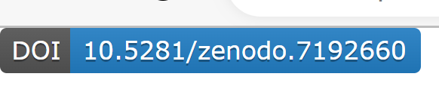
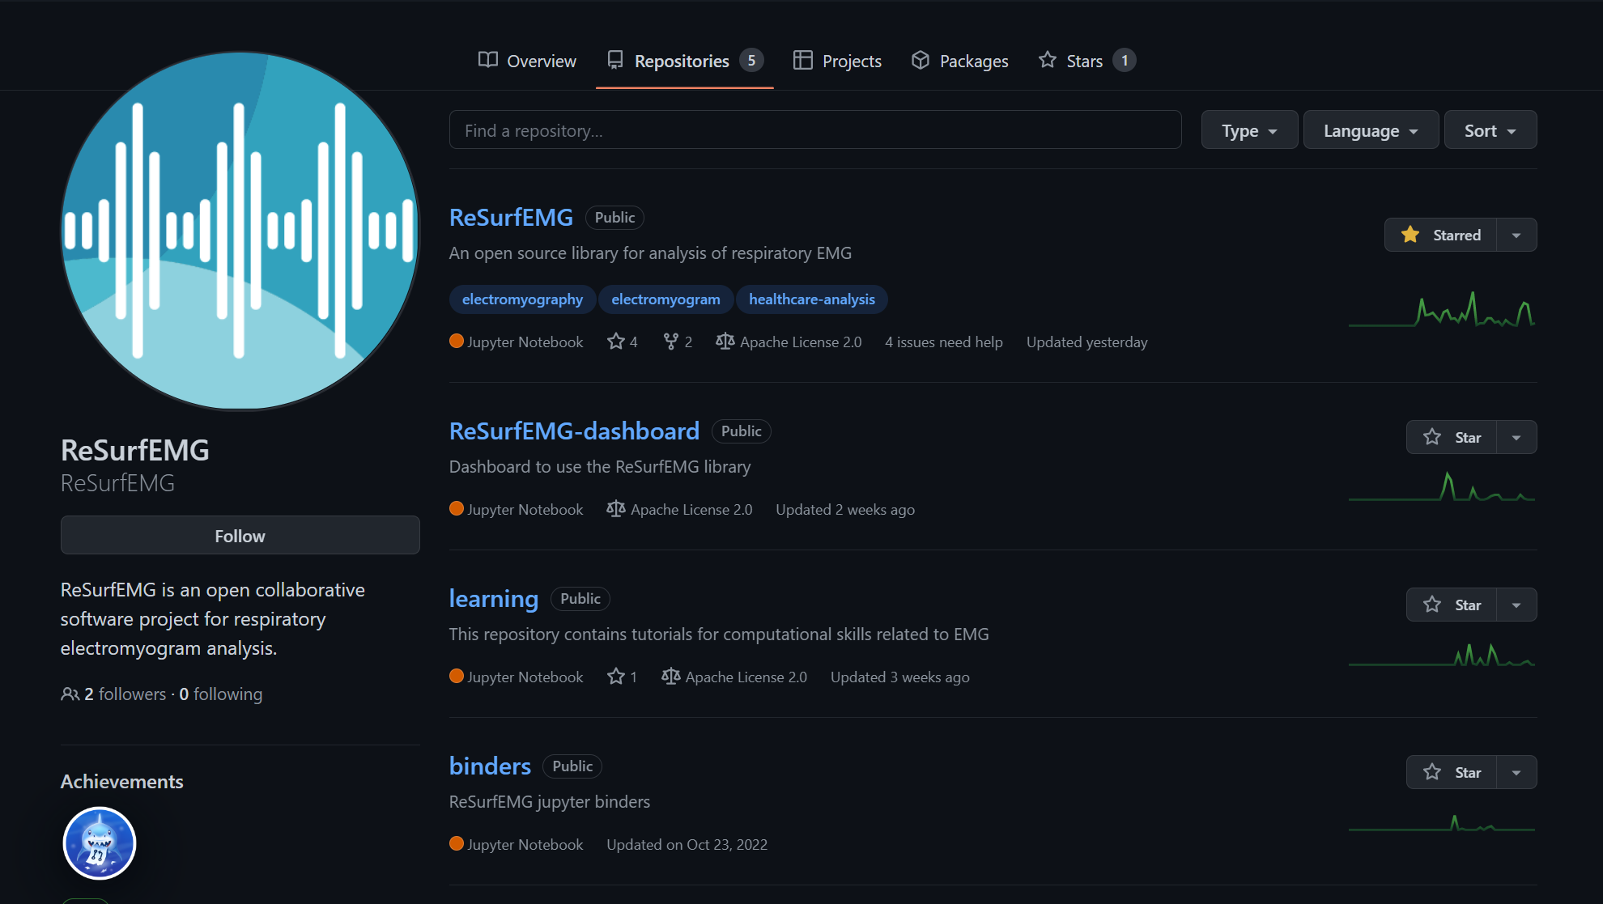
ReSurfEMG
Citable!
Freely usable for all!
A group of repositories currently led on the technical side by Dr. Walter Baccinelli and Dr. Candace Makeda which help scientists answer questions about respiratory muscle EMG
Developed with Dr. Oppersma and her PhD student Rob Warnaar
Meant to be used by multiple research groups
Notes:
How do we do that?
We collaborate with our scientific partners through projects and calls

Slide 8
ReSurfEMG
Goals:
Interactive Dashboard for preprocessing and more
Open Science
Learning repository
Standardization
Cross platform
Code library
✓ Open Source
Moving towards clinical tools
✓ Well documented
Documentation can be generated,
Found on readthedocs
Or on our own dedicated site
Collaborative community project
Notes:
How do we do that?
We collaborate with our scientific partners through projects and calls

Slide 9

Tutorial
Version control
Command line
Dashboard
Researcher Interface
Alternatives
Sustainability
Outside Collaborators
Inside Collaborators
Git
Database and tool for collaboration on code
Unlimited do-overs
Memory of everything done
Exercise 0: set up your Config file
Exercise 1: putting ReSurfEMG on your machine
Exercise 2: put ridethewave on your machine
Exercise 3: change ridethewave on your branch
Exercise 4: put Resurfemg-dashboard on your machine
Notes:
Software quality Is very important for us. So, in our projects we follow best practices for the software development.

Slide 10
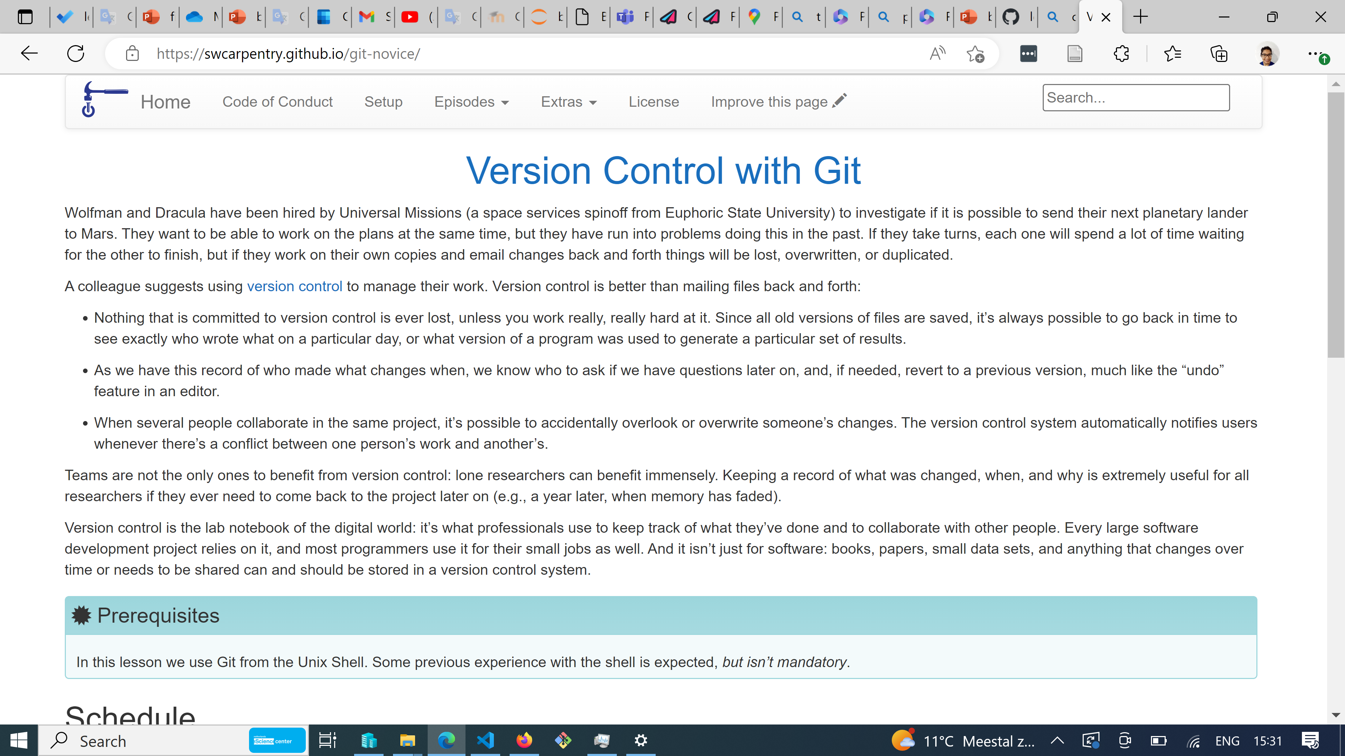
Tutorial
Version control
Command line
Dashboard
Researcher Interface
Alternatives
Sustainability
Outside Collaborators
Inside Collaborators
Git
Git is an amazing tool
Multiple complex possibilities
Learning possibilities
Notes:
Software quality Is very important for us. So, in our projects we follow best practices for the software development.

Slide 11
Tutorial
Version control
Command line
Dashboard
Researcher Interface
Alternatives
Sustainability
Command line is the fastest way around code
Exercise 5: Synthetic data creation
Want more command line? -> Opening issues
Need to examine stuff more closely?
Dashboard and or Researcher Interface
Notes:
Software quality Is very important for us. So, in our projects we follow best practices for the software development.

Slide 12
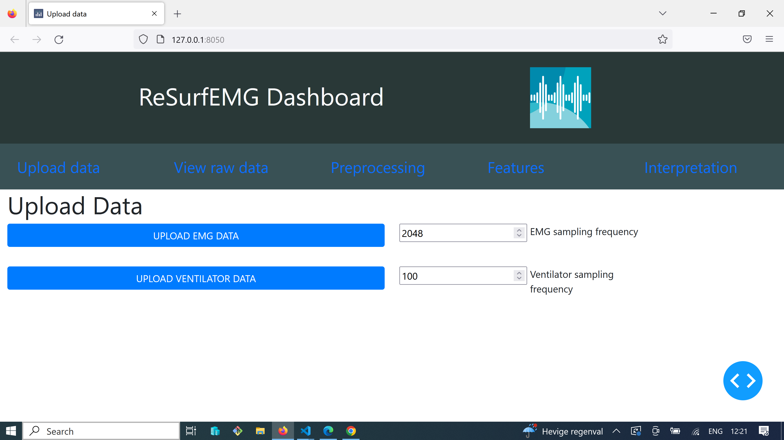
Tutorial
Version control
Command line
Dashboard
Researcher Interface
Alternatives
Sustainability
No code tooling
Exercise 6: Upload data, pre-process and save
Issues setting up? Download the executables here:
https://tinyurl.com/resurfemg-dash
Notes:
Software quality Is very important for us. So, in our projects we follow best practices for the software development.

Slide 13
Tutorial
Version control
Command line
Dashboard
Researcher Interface
Alternatives
Sustainability
Jupyter notebook based
Exercise 7: Observe run of a basic preprocessing over a synthetic EMG
Real world possibility:
Make your own fork of ReSurfEMG!
Notes:
Software quality Is very important for us. So, in our projects we follow best practices for the software development.

Slide 14
Alternatives and sustainability
Matlab
Neurokit2
pyemgpipeline
ReSurfEMG
Closed Source
Great library
JOSS reviewed
Will go to JOSS
Computational issues
BiosPPy
EMG lags
EMG specific
EMG specific
Open source, lots of good
Larger community
Small, and 'wrinkling'
"young"
Zero testing, not version controlled, not citable
Growing community
Software quality
developing workflows
friendly responsive team
advancing software sustainability
Please fork us and contribute!
Notes:
This is an overview of Our center in-house expertise.
Software quality, Analytics and Data processing are the most relevant for this project.

Slide 15
Best practices:
request features or functions: use issues
add your own functions (please share!)
install_dev
find the documentation or even build it
recommendations for code you send are in the documentation but generally we keep it pep-8, no merges
remember the library is for the community- it is your library too!
Notes:
This is an overview of Our center in-house expertise.
Software quality, Analytics and Data processing are the most relevant for this project.

Slide 16
Final thoughts/
Questions
Sharing knowledge and software
✓ Knowledge sharing
Let's stay in touch!
Email: resurfemg@gmail.com
Temporary code leader:
Dr. Candace Makeda Moore, MD
c.moore@esciencenter.nl
Temporary Leader of Dashboard:
Dr. Walter Baccinelli, PhD
Forever leader:
Dr. Eline Mos-Oppersma, PhD
Collaborative projects
Research software
Academic researchers
Our together working is next week Friday!
Others will be scheduled
Open issues, and we will work on them
Close issues and become a legend
Notes:
We share our knowledge by publishing papers with our parners and releasing open source software. But besides publishing, we disseminate our knowledge by offering workshops in areas of our expertise.

